Slide 1
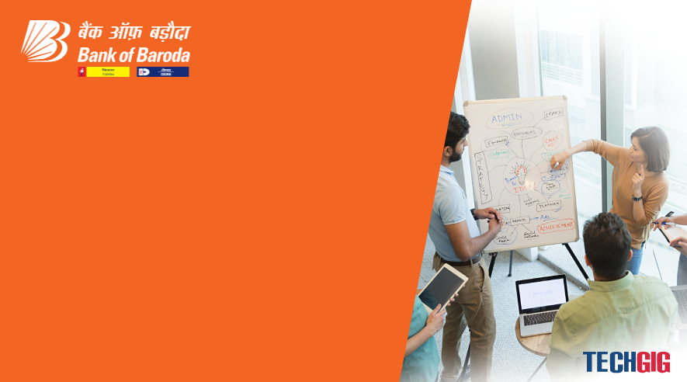

Bank of Baroda Hackathon - 2022
Technology Partner
Your Team Name : Mind Optimizer
Your team bio : We are engineering students. Studing at Mangayarkarasi College of Engineering. We are interested in learning about new technologies like artificial intelligence, big data, cybersecurity and more. We focus on something to do for society, so we use this opportunity.
Date : 12.09.2022

Slide 2
Problem Statement
Authentication measures of Caller ID / PIN (personal identification numbers) / Security Questions / Device Signatures are sometime inadequate and intrusive. Identify creative methods of Customer Authentication which can be used on various channels. This should be done without deteriorating the customer experience.
Why did you decide to solve this Problem statement?
We are interested in cyber security, which is the primary reason we chose this issue statement.
Using digital money, everyone appears to be moving away from using cash. Making ensuring that all cybersecurity precautions are in place in this situation is crucial for protecting your privacy and data while using mobile banking.

Slide 3
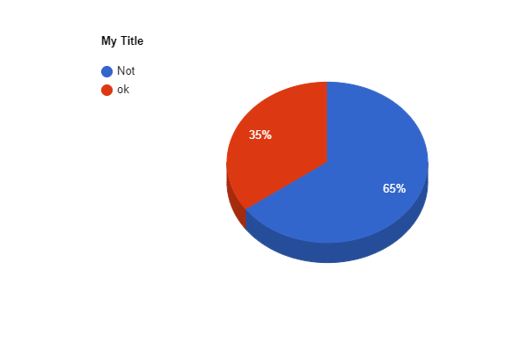
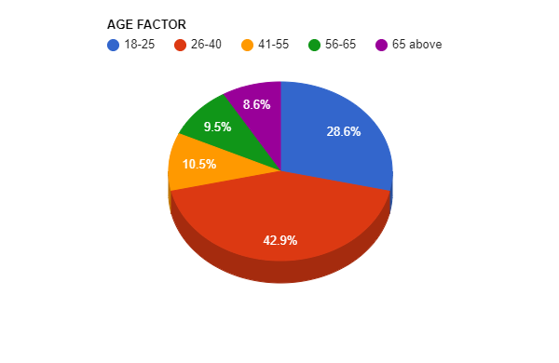
User Segment
Observe that according to survey(RBI) around 68% of the total people who answered the survey are using e-banking. Today in India (according to RBI statistics) around 35 % of the population is using E-Banking for daily transactions. In the near future this number will increase by 50-60%.
In that 35% of E-Banking usage, around 5% of visually impacted people using E-Banking.
E-Banking Usage In India
India
E-Banking Usage Age Factor
Not Using E-Bank
Using E-Bank

Slide 4
Pain Points
People who are visually impacted are unable to use e-banking.
Aged people can't remember their own pin or password during authentication process.

Slide 5
Pre-Requisite
Tensorflow (Deep learning).
Flask - Web framework used for building Web applications.
Existing
Apple’s Strategy
In the latest iPhones, such as the X, 11, 12, and 13, double tapping the power button confirms that the user is ready for face authentication when purchasing any app from Apple's app store.

Slide 6
Azure tools or resources
Knowledge Center
Code Samples
Solution architectures
Case studies
White papers
Sdk Downloads

Slide 7
Methodology
Authentication via volume button gestures.
While pressing the volume button, various haptic vibrations or sounds will be played for recognition (especially for the physically challenged).
Next, face ID verification will be processed .
Once authentication is done, customers can log in to their accounts.
If face verification fails, you have to enter your ELP(emergency login pin).
By using this ELP, you are allowed to log in to your account up to 3 times per day .
While entering the ELP, if it's wrong, you have 3 attempts per day, otherwise your access will be blocked for the next 24 hours.

Slide 8
Key Differentiators & Adoption Plan
There is only fingerprint recognition or security pin used for authentication in mobile banking.
The drawback of using this method is that physically challenged people won't be aware of whether they are entering the correct pin or not.
Also, there will be chances of low security while using a security pin.
In the beginning, authentication via volume button is done in this method.
The various haptic vibrations are used for tapping recognition, especially for the physically challenged. Following that, face ID authentication is used for customer facial recognition, which begins without their interaction.
Both authentication processes contribute to the security of E-banking for both regular and physically challenged users.

Slide 9
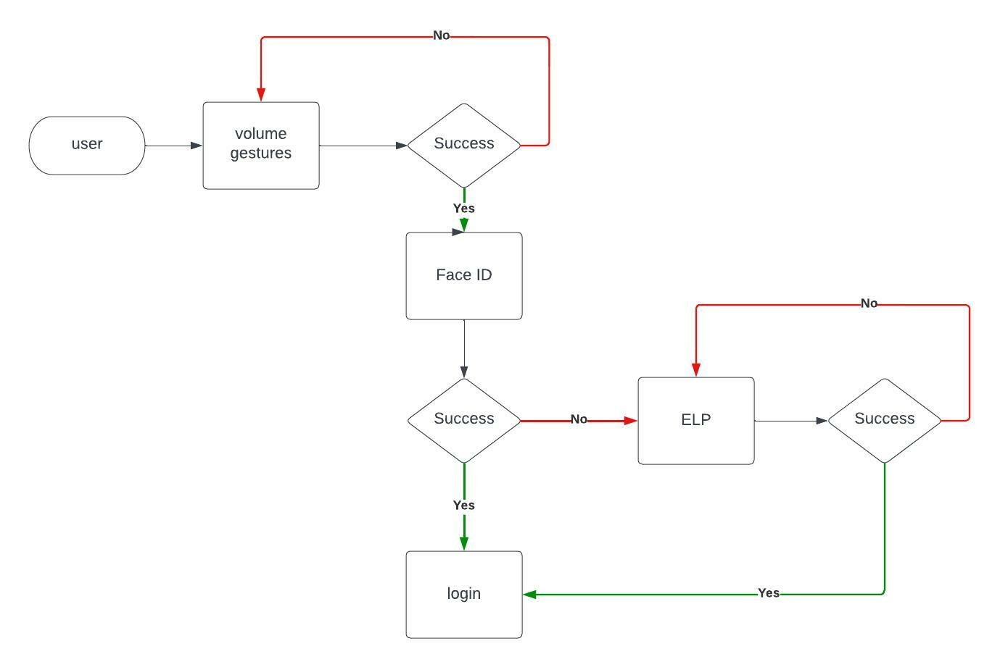
Prototype or Flow Chart Diagram

Slide 10

Thank You
Mr. Jeyaprasanna S (923819104017)
Mr. Karthikeyan A (923819104019)
Mr. MugeshKumar M (923819104026)
Ms. Vasuki P (923819104057)
Mangayarkarasi College Of Engineering
Department Of Computer Science & Engineering
(Final Year Students)

